Slide 1



SONG ANALYSIS
USING POWER BI |
Presented By
Raja Israr Azam Kiani

Slide 2

Overview
This project analyzes YouTube song data using Power BI to uncover insights into performance, engagement, and trends. By examining key metrics such as views, likes, and comments, the analysis provides actionable recommendations for content optimization. The goal is to help content creators and stakeholders understand audience preferences, improve video performance, and enhance engagement and visibility on the platform.

Slide 3

Process Overview
02
Dashboard
03
Recommendations
01
Data Cleaning
Prepare and preprocess the dataset
Creation
Load data into Power BI and build Dashboards
Analyze visualizations and provide actionable advice

Slide 4

Dataset Description
★ video_id: Unique identiﬁer for each YouTube video.
★ channelTitle: Title of the YouTube channel publishing the song.
★ title: Title of the YouTube song video.
★ description: Description provided for the YouTube song video.
★ tags: Tags associated with the YouTube song video.
★ publishedAt: Date and time when the YouTube song video was published.
★ viewCount: Number of views received by the YouTube song video.
★ likeCount: Number of likes received by the YouTube song video.
★ favoriteCount: Number of times the YouTube song video has been marked as a
favorite.
★ commentCount: Number of comments posted on the YouTube song video.
★ duration: Duration of the YouTube song video.
★ deﬁnition: Video deﬁnition or quality (e.g., HD, SD).
★ caption: Availability of captions for the YouTube song video.

Slide 5

Data Cleaning
Prepare and Preprocess the dataset
01

Slide 6
❏ Handle Missing Values: Identify and address missing or
incomplete data entries.
❏ Date Formatting: Convert and standardize date and time
formats for consistency.
❏ Feature Extraction: Extract and create relevant features for
analysis (e.g., extracting the month from the publish date).
❏ Data Transformation: Normalize and transform data ﬁelds as needed for accurate analysis.
❏ Data Validation: Ensure data accuracy and consistency
throughout the dataset.

Slide 7


Dashboard Creation
02
Load data into Power BI and
build Dashboards

Slide 8

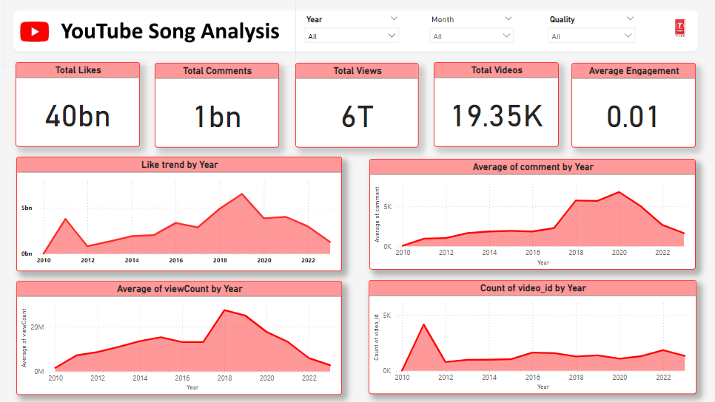
Dashboard Design

Slide 9
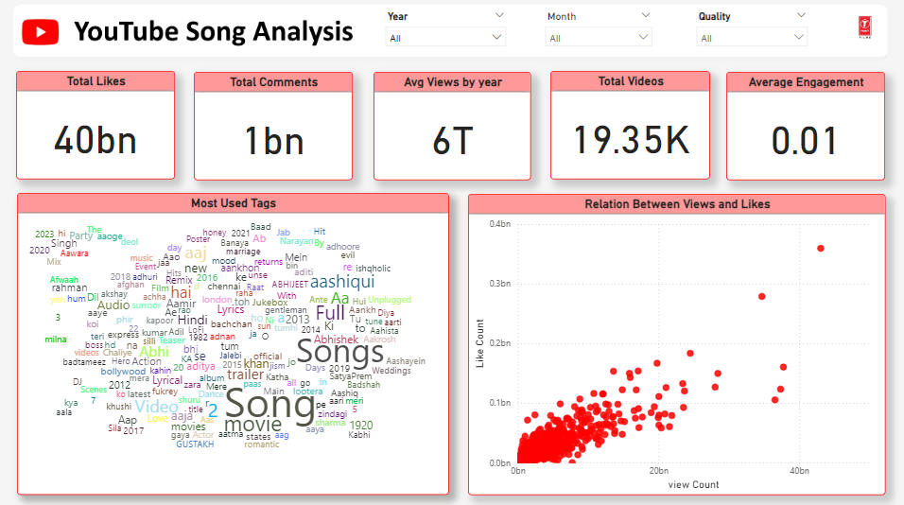
Dashboard Design

Slide 10
Dashboard Visuals
★ Average Views by year: Displaying a total of 231 billion views.
★ Total Likes: Displaying a total of 2 billion likes.
★ Total Comments: Displaying a total of 51million comments.
★ Total videos: Count of videos.
★ Like count by year
★ Average comments by year
★ Average comments by year
★ Most used Tags: word cloud is used
★ Relationship between views and likes

Slide 11

Recommendations
Analyze visualizations and provide actionable advice
03

Slide 12
❏ Leverage popular songs: Create more content around songs
similar to the top 5 videos by views.
❏ Optimize video length: Keep videos concise for higher view
counts.
❏ Improve video quality:Upload videos in HD for better
engagement.
❏ Add captions: Increase accessibility with captions.
❏ Boost like rate: Use call-to-action prompts to encourage likes.
❏ Post at optimal times: Identify best times to post using
publish_month data.
❏ Engage with audience: Encourage comments to boost
interaction.

Slide 13
Conclusion
Analyzing YouTube provides valuable optimizing content
song data insights for strategies. By
leveraging key metrics and trends, content creators can enhance video performance, engage with audiences more effectively, and ultimately achieve greater success on the platform.

Slide 14

THANK YOU

